Slide 1
NAD v. Netflix: A Landmark Case for Accessible Streaming
CM2045
Midterm Case Study Presentation

Slide 2
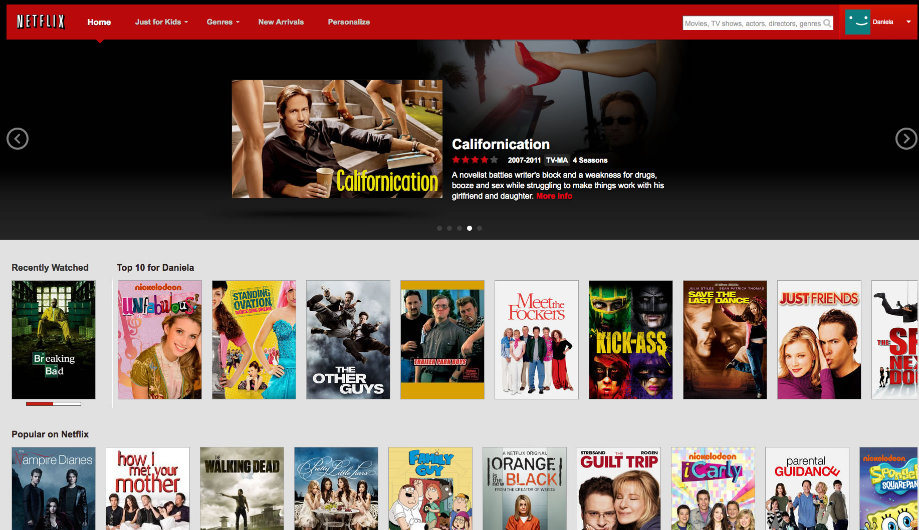
Img: Netflix 2011 UI

Slide 3
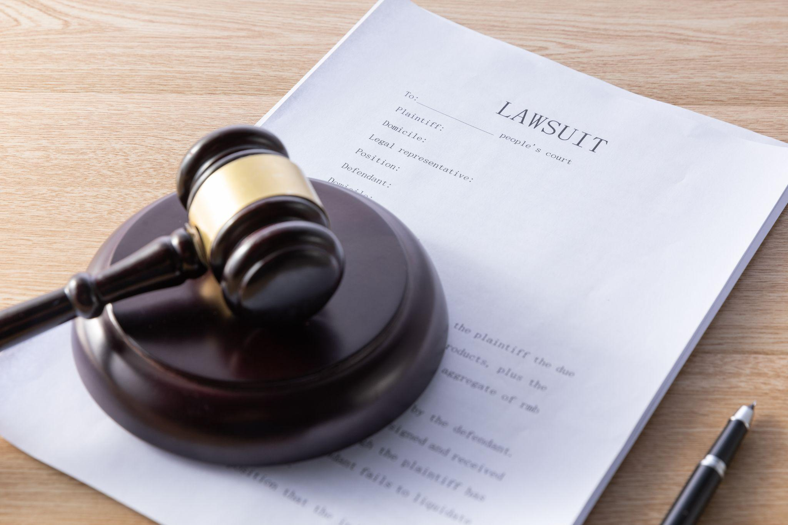
Background
Netflix dominated streaming in 2011, but lacked closed captions on most content.
NAD (National Association of the Deaf) advocated for equal access.
Without captions, deaf users were excluded from digital media.
NAD filed a lawsuit under ADA Title III to compel change.

Slide 4
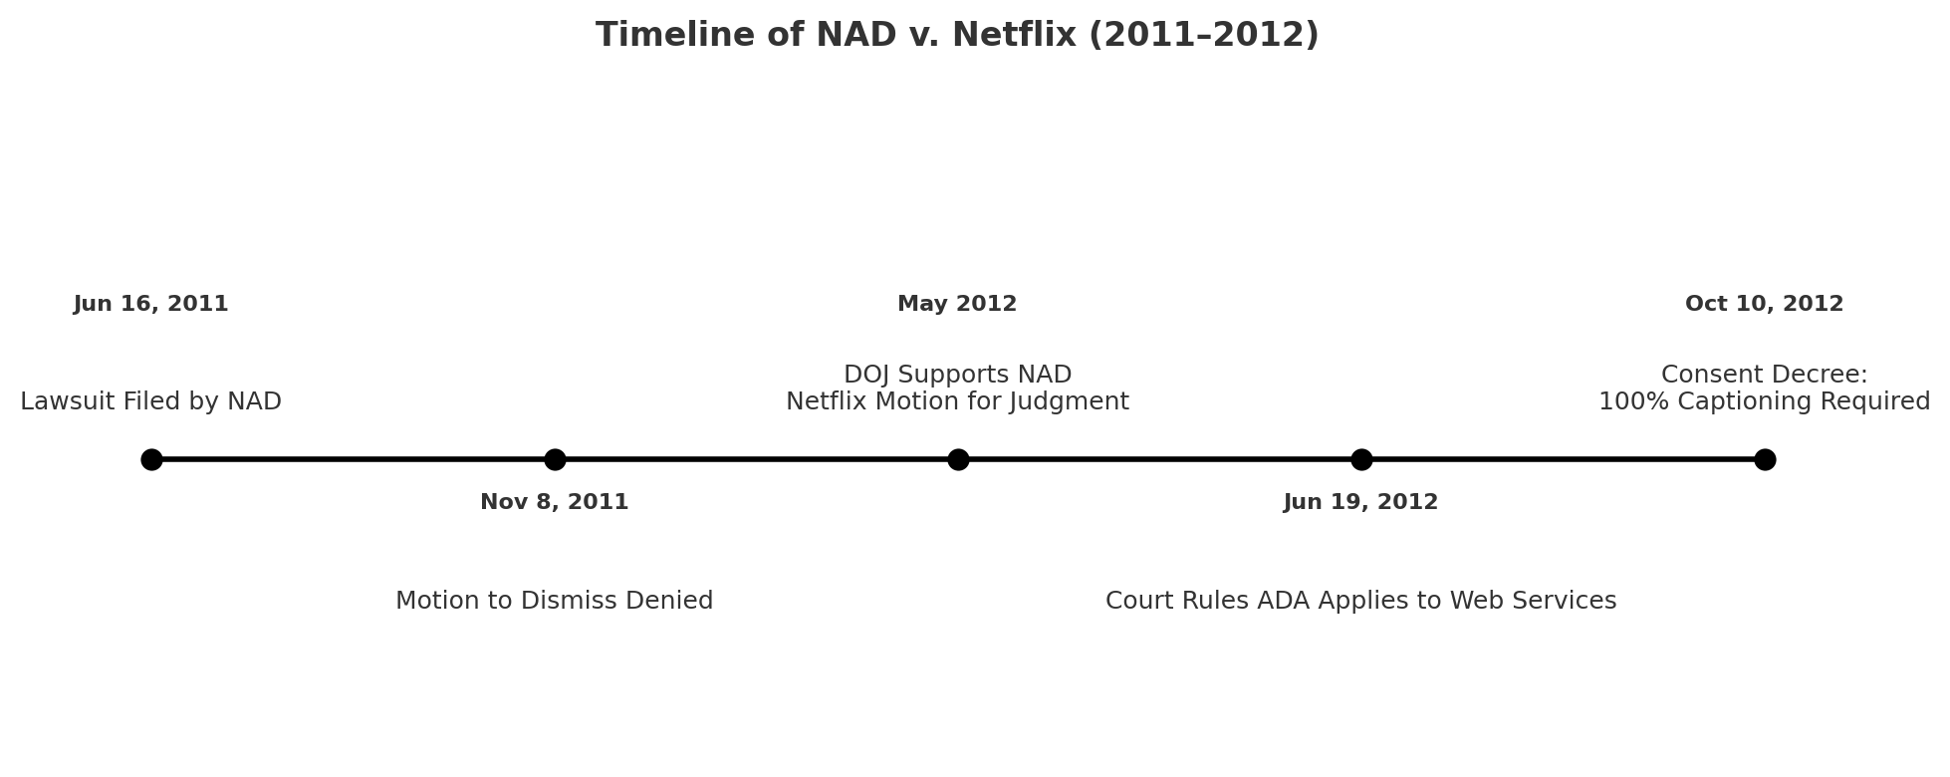
What happened?

Slide 5
Key Legal Milestones (2011–2012)
Jun 2011: NAD filed lawsuit
Nov 2011: Motion to dismiss denied
May 2012: DOJ backed NAD
Jun 2012: Court ruled ADA applies to web-only services
Oct 2012: Settlement required 100% captioning by 2014

Slide 6
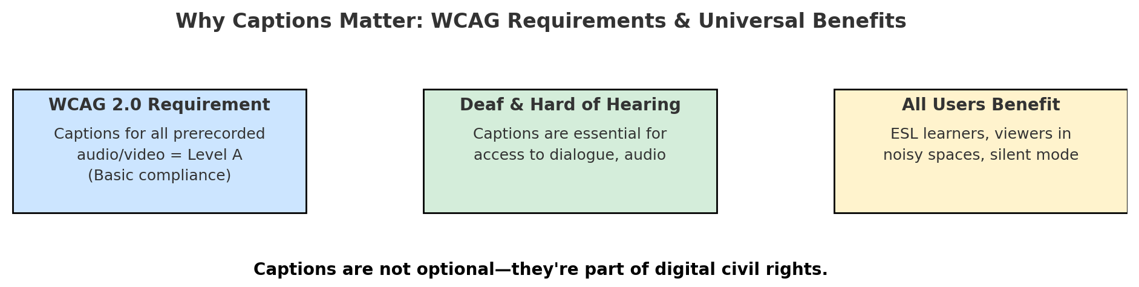
Accessibility and User Impact
Captions are essential for deaf and hard-of-hearing users.
Lack of captions led to isolation and exclusion.
Case raised awareness and drove industry-wide accessibility improvements.
Netflix became a model for streaming caption compliance.

Slide 7
Court Decision and Legal Significance
ADA applies to digital-only services.
DOJ supported NAD's view.
Court rejected Netflix's arguments.
Precedent set for future web accessibility lawsuits.

Slide 8
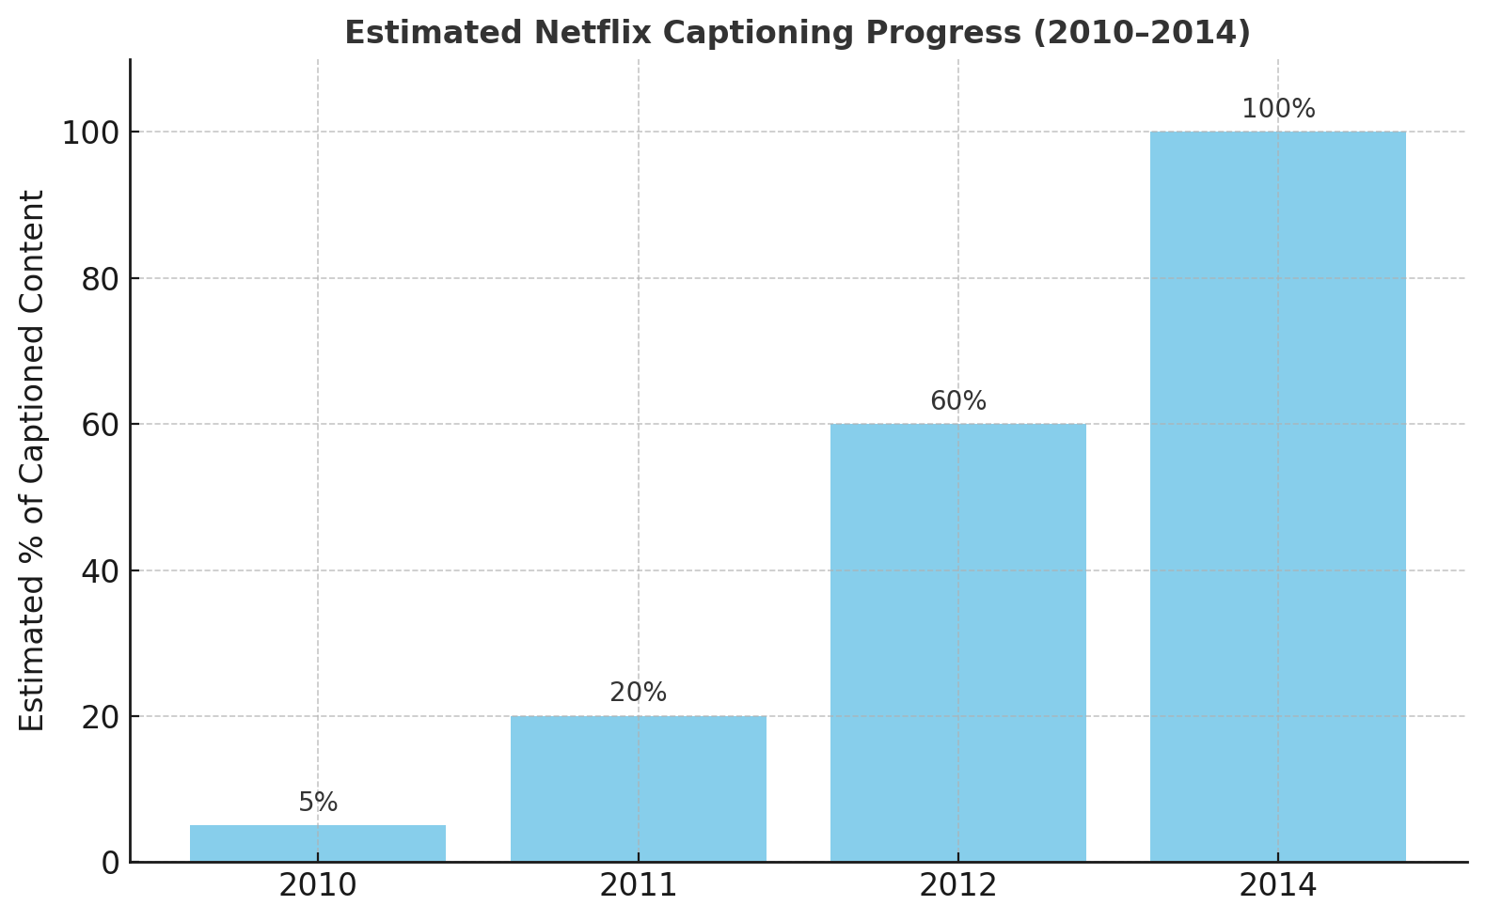
And the result?

Slide 9

Lessons and Recommendations
Accessibility is a civil right and legal requirement.
Captions should be standard from launch.
Collaborate with advocacy groups.
Design for all users – universal design improves UX.
Track accessibility and train development teams.

Slide 10
Thank You

